Slide 1
Energy Consumption Analysis
CAREER FAIR DATA ANALYSIS PROJECT
Submitted by
Nalina Lingasamy
DTM10

Slide 2
Problem Statement
This project will analyze energy usage and greenhouse gas (GHG) emissions of Ontario's Broader Public Sector (BPS) organizations, leveraging a comprehensive database of reported data.
This is to identify trends, assess conservation effectiveness, and pinpoint areas for improvement, informing data-driven strategies to achieve climate change mitigation goals within the BPS.

Slide 3
Technologies Used
Data Cleansing
Exploratory Data Analysis (EDA)
Visualization (Power BI)

Slide 4
Data Understanding
The Dataset spans from 2012 to 2021 and contains information about BPS organizations, including public hospitals and school boards.
Key attributes include organization details, operational information, energy consumption data, and GHG emissions.

Slide 5
Exploratory Data Analysis
Data sets were loaded from the official page of Ontario's Broader Public Sector (BPS) (Dataset).
After loading data for all the years from 2012 to 2020 to Jupyter notebook, the following steps were done.
Each excel file was converted into dataframe by using Pandas library.
Null values were checked and null value imputation was done.
Once null values were treated, all the dataframes were concatenated to a single final dataframe.
The final dataframe was then saved as a file in excel format and loaded to PowerBI for further analysis and visualizations.

Slide 6
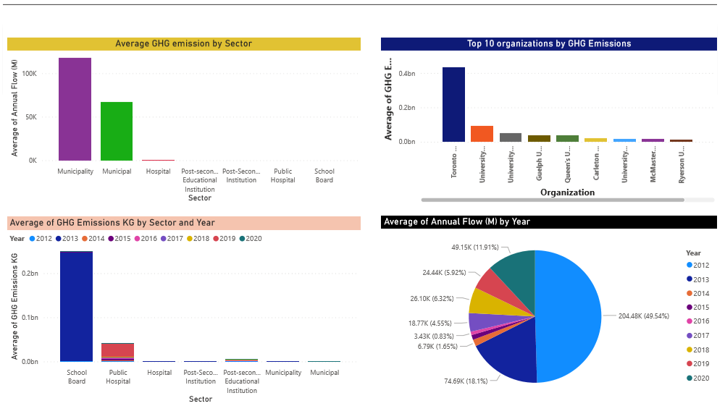
PowerBI reports

Slide 7
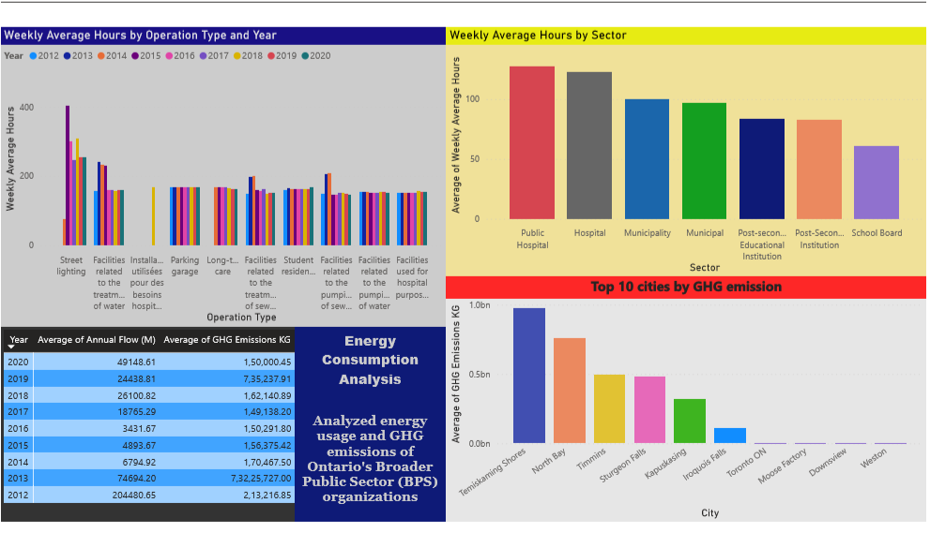
PowerBI reports

Slide 8
Variability in Annual Flow (M)
Average of Annual Flow (M) was highest for Municipality at 1,17,587.10, followed by Municipal and Hospital.﻿﻿ ﻿﻿ ﻿﻿Across all 7 Sector, Average of Annual Flow (M) ranged from 0.00 to 1,17,587.10
The average annual flow (M) varies significantly across different municipalities, with the highest average being 1,17,587.10 for Municipality, followed by Municipal and Hospital.
This suggests that certain municipalities may have higher energy consumption needs compared to others.
Across all 7 sectors, the average annual flow (M) ranges from 0.00 to 1,17,587.10.
This wide range indicates disparities in energy usage across different sectors, with some sectors potentially being more energy-intensive than others

Slide 9
Variability in GHG Emissions Across Organizations
There is substantial variability in GHG emissions across different organizations, with Toronto Mount Sinai Hospital having the highest average GHG emissions (KG) at 43,48,08,151.03.
This is 4,351.01% higher than University of Waterloo, which has the lowest average GHG emissions (KG) at 97,68,757.68.
This suggests that certain organizations may have higher carbon footprints compared to others.
Certain organizations, such as hospitals and educational institutions, have a significant impact on energy consumption and greenhouse gas emissions.
Implementing energy efficiency measures and promoting sustainable practices in these organizations can lead to substantial reductions in emissions.

Slide 10
Contribution of GHG Emissions by School Board
﻿School Board in Year 2013 made up 82.66% of Average of GHG Emissions KG.﻿﻿ ﻿﻿
This highlights the significant impact of educational institutions on GHG emissions and the importance of implementing sustainable practices in schools.

Slide 11
Range of GHG Emissions Across Cities
﻿﻿Across all 10 City, Average of GHG Emissions KG ranged from 18,26,267.51 to 97,32,45,745.73.﻿﻿
At 97,32,45,745.73, Timiskaming Shores had the highest Average of GHG Emissions KG and was 53,191.52% higher than Weston, which had the lowest Average of GHG Emissions KG at 18,26,267.51.﻿﻿
This wide range indicates disparities in GHG emissions levels across different cities, possibly due to variations in population density, industrial activities, and transportation infrastructure.

Slide 12
Contribution of Street Lighting to Weekly Average Hours
﻿Street lighting in Year 2015 made up 2.99% of Average of Weekly Average Hours.﻿﻿ ﻿
This suggests that street lighting plays a relatively minor role in overall energy consumption compared to other sectors.
Optimizing street lighting systems with energy-efficient technologies can still contribute to energy savings and environmental sustainability.

Slide 13
Variability in Weekly Average Hours Across Sectors
Public Hospital had the highest Average of Weekly Average Hours and was 108.50% higher than School Board, which had the lowest Average of Weekly Average Hours at 61.11.﻿﻿ ﻿﻿
﻿﻿﻿Across all 7 Sector, Average of Weekly Average Hours ranged from 61.11 to 127.41.﻿﻿ ﻿﻿ ﻿
This variability indicates differences in energy usage patterns across different sectors, with some sectors requiring more energy for operational purposes.
It is essential to understand the specific needs and characteristics of each sector to develop targeted strategies for energy management and sustainability initiatives.

Slide 14
Spatial Variability
There is significant spatial variability in energy usage and greenhouse gas emissions across different municipalities, sectors, organizations, and cities.
Understanding these spatial patterns can help identify areas with high energy consumption and prioritize efforts for energy efficiency improvements and emissions reductions.

Slide 15
Future Directions
Implementing data-driven energy management strategies to identify opportunities for efficiency improvements.
Promoting renewable energy adoption and low-carbon technologies to reduce reliance on fossil fuels.
Enhancing collaboration between municipalities, organizations, and cities to share best practices and address common challenges.
Engaging stakeholders and communities in energy conservation initiatives and fostering a culture of sustainability.
Monitoring and evaluating the effectiveness of energy efficiency programs to ensure continuous improvement and progress towards sustainability goals.

Slide 16



